Slide 1
_VOIS Explore Program 2024
Mobile Development Guild

Slide 2
Agenda:
About Me.
What I've learned.
Demo.

Slide 3
About Me.
1

Slide 4
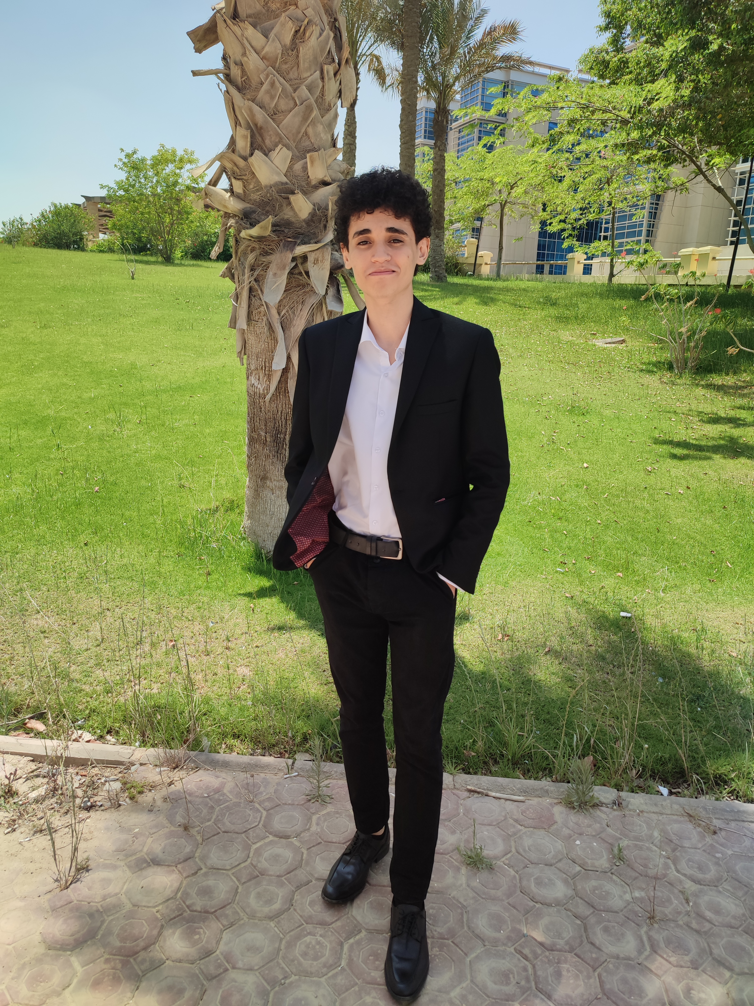
About Me
Senior CS Student at Nile University ( GPA 3.6 )
Ahmed Amin
Software Engineer : Experienced in developing web applications and passionate about coding
About Self-Improvement : Committed to improving mentally, emotionally, and educationally
Continuous Learner: Always seeking new knowledge and experiences to grow personally and professionally
Cultural and Language Enthusiast : Passionate about learning about different cultures, exploring diverse perspectives, and acquiring new languages to communicate across cultures.

Slide 5
What I've learned.
2

Slide 6
The Explore Program make me aware of many things:
- Gained hands-on experience in Agile methodologies - Learned Android development basics, including Kotlin, Android components, and Jetpack Compose. - Explored API integration - Developed skills in version control using GIT for collaborative development. -Introduced to iOS development, including Swift, SwiftUI, and UIKit for creating intuitive user interfaces.

Slide 7
How I Learned During the _VOIS Explore Program
Collaborative Teammates
Teamwork: My teammates were incredibly collaborative and helpful, fostering an environment of shared learning and problem-solving.
Shared Knowledge: Working together allowed us to learn from each other's strengths and experiences, enhancing our overall understanding of the technology and practices.
Supportive Mentors
Guidance and Expertise: We had amazing senior mentors who provided invaluable support and guidance throughout every session.
Hands-On Help: Their expertise and feedback were crucial in mastering Agile methodologies, Android development basics, API integration, and more.

Slide 8
Demo.
3

Slide 9


Slide 10
Thank You

